Slide 1




MARKETPLACE FOR NORTHWEST One place to buy and sell
Sec 03 TEAM03
DR. CHANDRA MOULI KOTTETI – Client/Mentor
USHA PATI – Tester/QA
KIRAN KUMAR GUNDAPUNENI – Backend developer
HARI KIRAN ALURI – Front End Developer
Sajida MOHAMMAD – Backend developer

Slide 2





TEAM MEMBERS
USHA PATI
KIRAN KUMAR
GUNDAPUNENI
DR.CHANDRA MOULI
KOTTETI
HARI KIRAN ALURI
SAJIDA MOHAMMAD

Slide 3
AGENDA
1
Introduction of project
Entity relationship diagram
Amazon RDS
Product Registration API
Spring Boot – DB connectivity
JPA Repository
Presented By Usha Pati

Slide 4
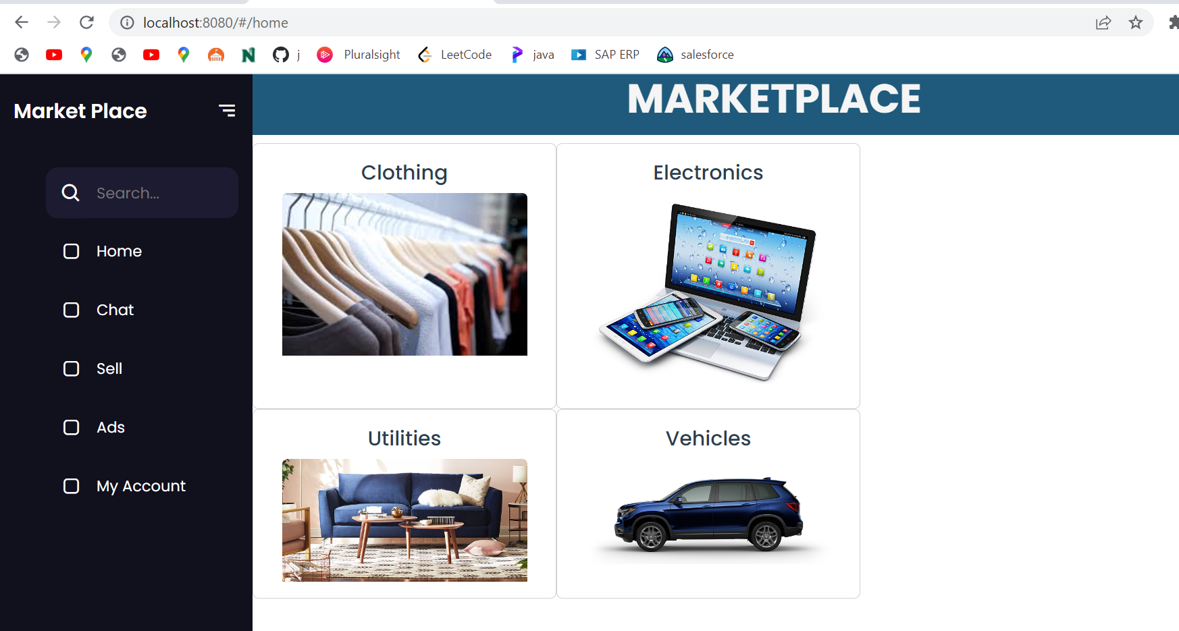

INTRODUCTION OF PROJECT
2
Fig.1.1 Logo of Northwest Market Place
Fig.1.2 Project Main Page
Presented By Usha Pati

Slide 5
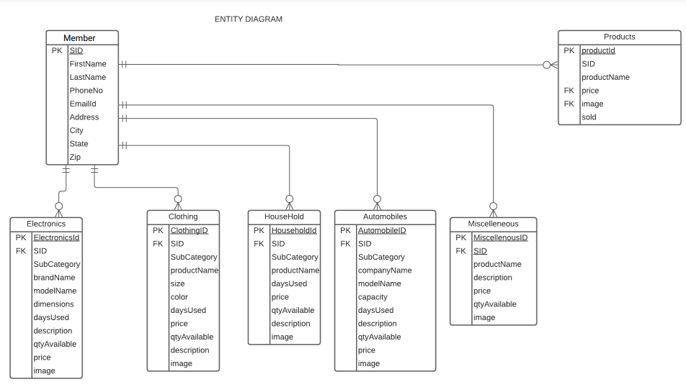
ENTITY RELATIONSHIP DIAGRAM
3
Fig.1.3 ER Diagram
Presented By Usha Pati

Slide 6
AMAZON AWS RDS
4
In recent days, database are no longer hosted on physical servers, instead on cloud server
We can create tables or do crud operations in the database from the local to remote.
Presented By Kiran Gundapuneni

Slide 7
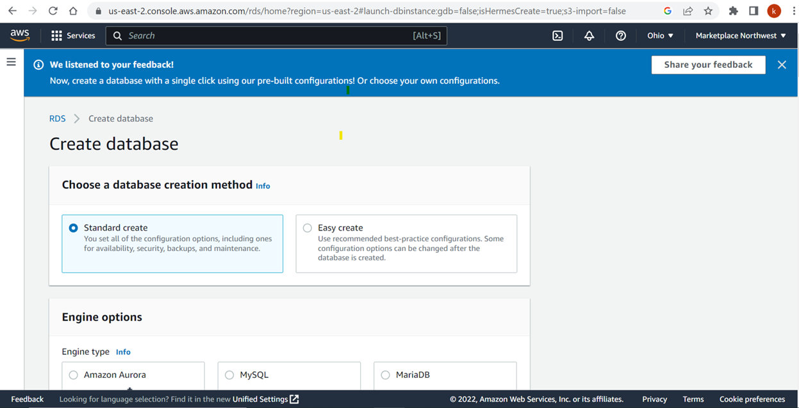
5
OPT FOR DATABASE METHOD
Presented By Kiran Gundapuneni
Fig.2.1 Database Creation

Slide 8
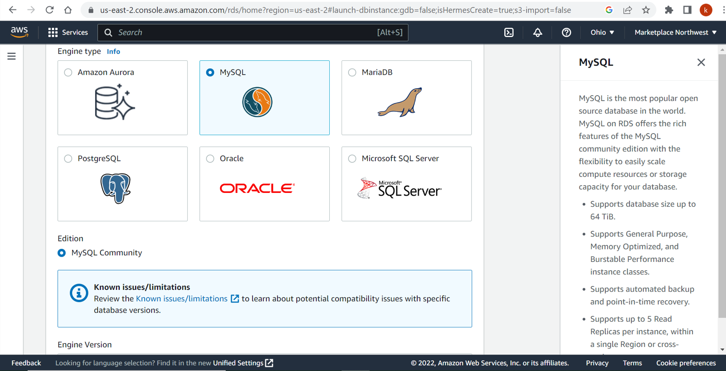
6
SELECTING DATABASE IN RDS
Presented By Kiran Gundapuneni
Fig.2.2 Database Selection

Slide 9
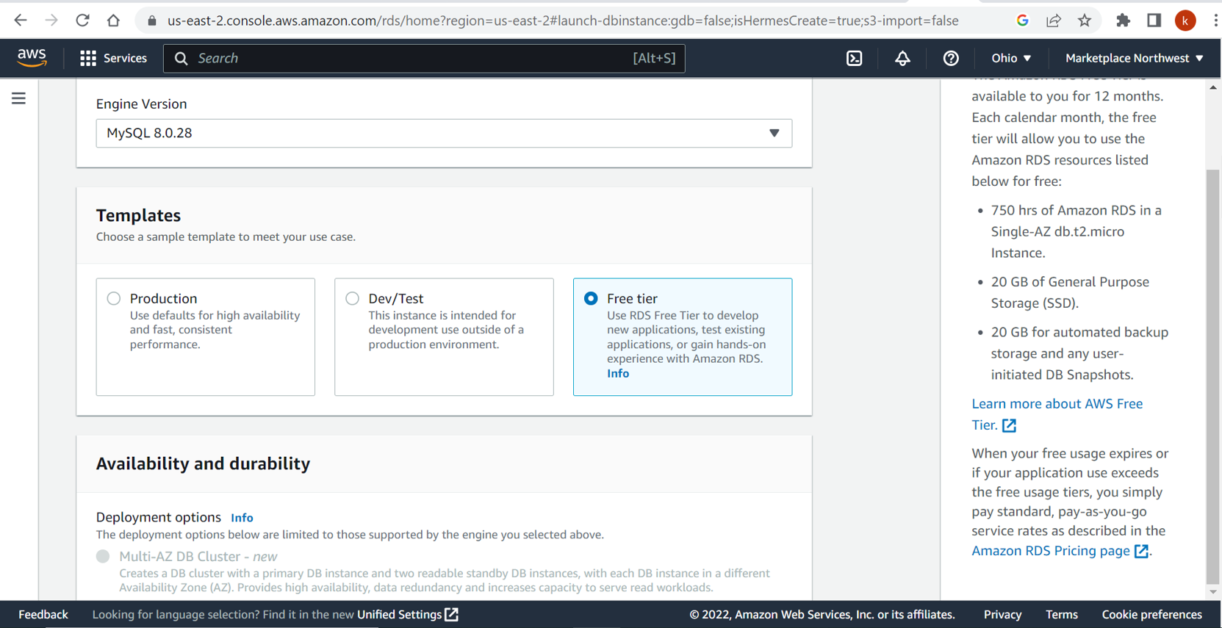
7
SELECTING DATABASE ENVIRONMENT
Presented By Kiran Gundapuneni
Fig.2.3 Environment Selection

Slide 10
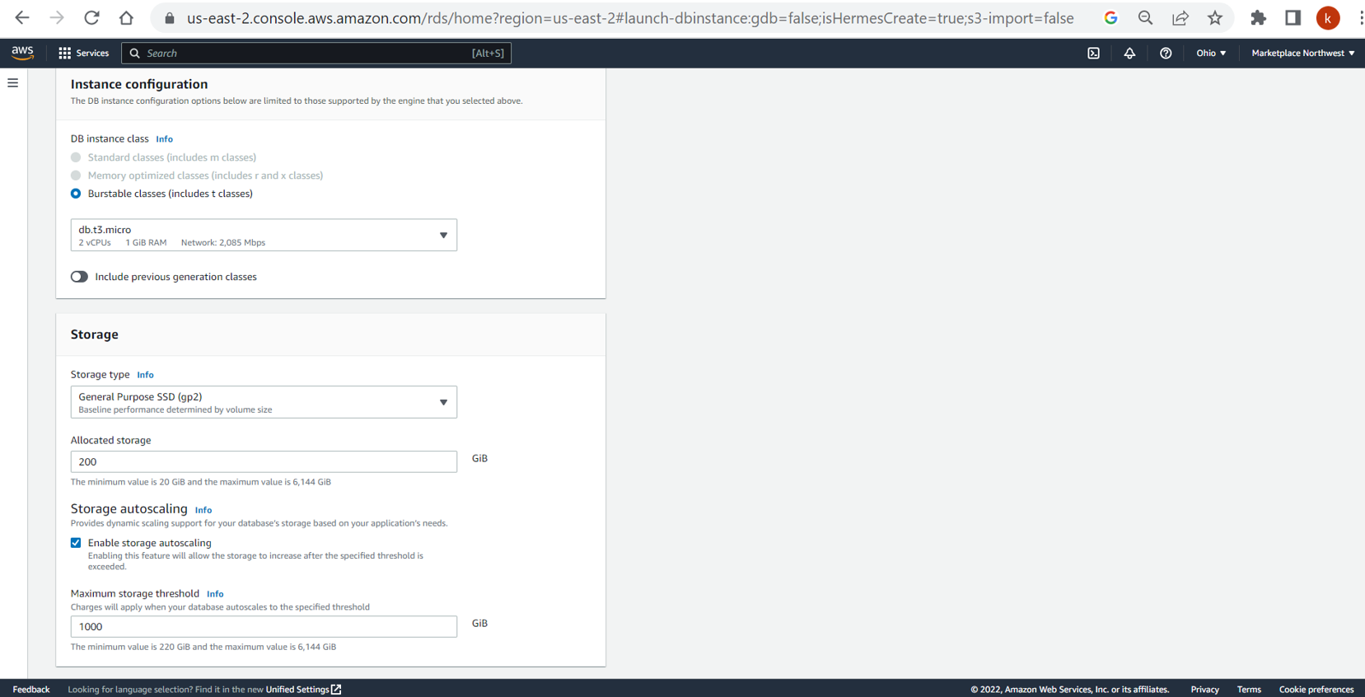
8
INSTANCE CONFIGURATION
Presented By Kiran Gundapuneni
Fig.2.4 Database Configuration

Slide 11
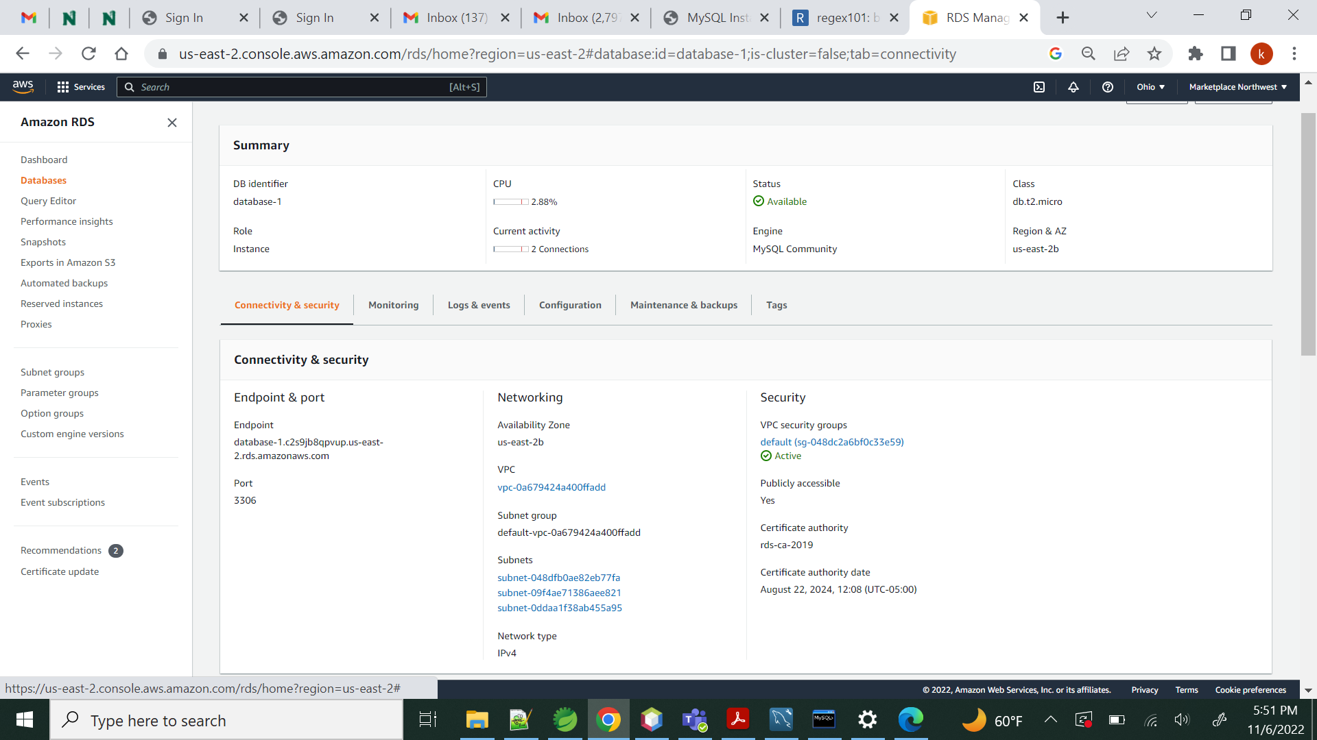
9
DATABASE ENDPOINT/SUMMARY
Presented By Kiran Gundapuneni
Fig.2.5 Database Summary/Endpoint

Slide 12
CONNECT TO REMOTE FROM LOCAL
10
Once, a remote database is setup we can connect it from our local machine with the endpoint details
We can create tables or do crud operations in the database from the local to remote
Presented By Kiran Gundapuneni

Slide 13
Angular
11
Angular is a development platform, built on TypeScript. As a platform, Angular includes:
A component-based framework for building scalable web applications
A collection of well-integrated libraries that cover a wide variety of features, including routing, forms management, client-server communication, and more
A suite of developer tools to help you develop, build, test, and update your code
Presented By Aluri Hari Kiran

Slide 14
Component
12
Components are the building blocks that compose an application.
A component includes a TypeScript class with a @Component decorator,
an HTML template, and styles. The @Component decorator specifies
the following Angular-specific information:
A CSS selector that defines how the component is used in a template.
HTML elements in your template that match this selector become instances of the component.
An HTML template that instructs Angular how to render the component
An optional set of CSS styles that define the appearance of the template's HTML elements
Presented By Aluri Hari Kiran

Slide 15
PRODUCT REGISTRATION API
13
1)In order to sell some Product, the Seller needs to enter some basic properties of the Product like name ,category , year of purchase , quantity available
2)the products are divided based on the category of the product like electronics ,households ,clothing.
3)the data that is enter by the user will be stored in the database and should be displayed to the buyer
Presented By Aluri Hari Kiran

Slide 16
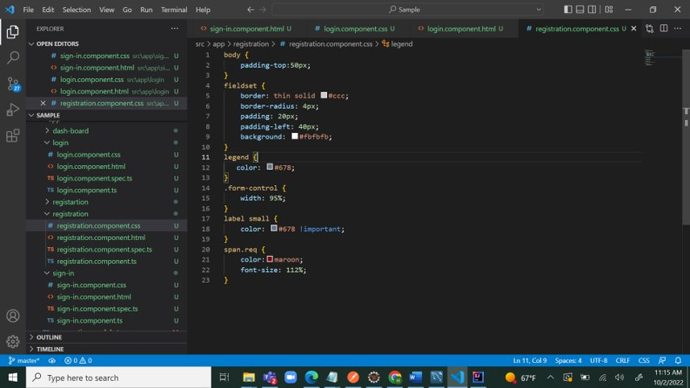
CSS File
14
Fig.3.1 CSS file in angular
Presented By Aluri Hari Kiran

Slide 17
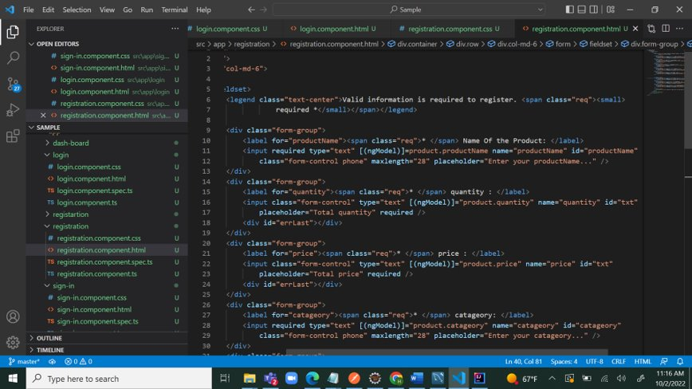
HTML
15
Fig.3.2 HTML file in angular
Presented By Aluri Hari Kiran

Slide 18
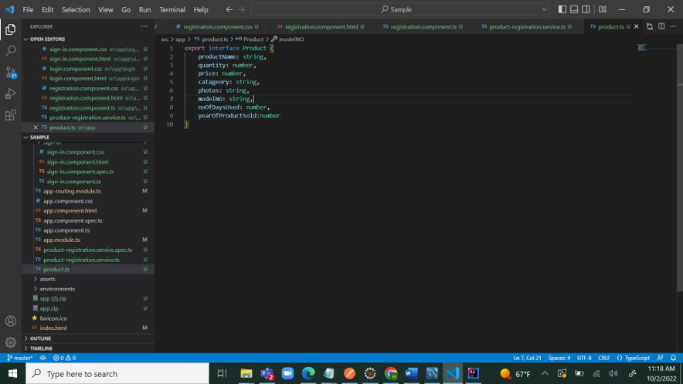
TYPESCRIPT FILE
16
Presented By Aluri Hari Kiran
Fig.3.3 TS file In angular

Slide 19
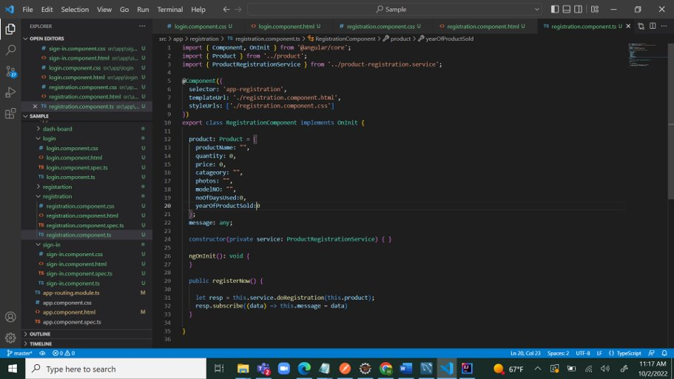
COMPONENT.TS FILE
17
Fig.3.4 Component file in angular
Presented By Aluri Hari Kiran

Slide 20
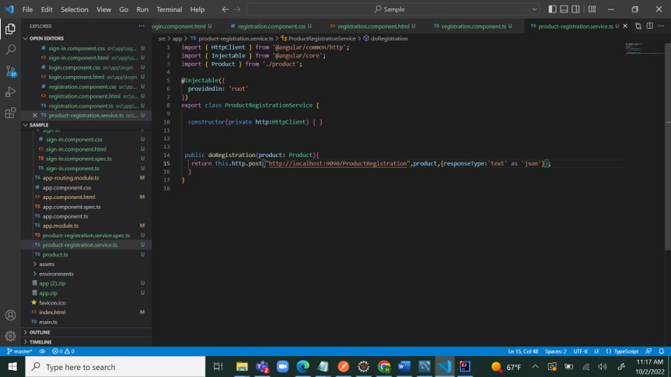
SERVICE.TS FILE
18
Fig.3.5 Service.ts file in angular
Presented By Aluri Hari Kiran

Slide 21
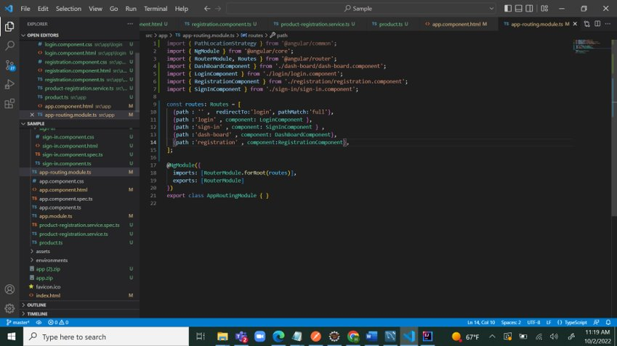
ROUTING MODULE
19
Fig.3.6 routing module in angular
Presented By Aluri Hari Kiran

Slide 22
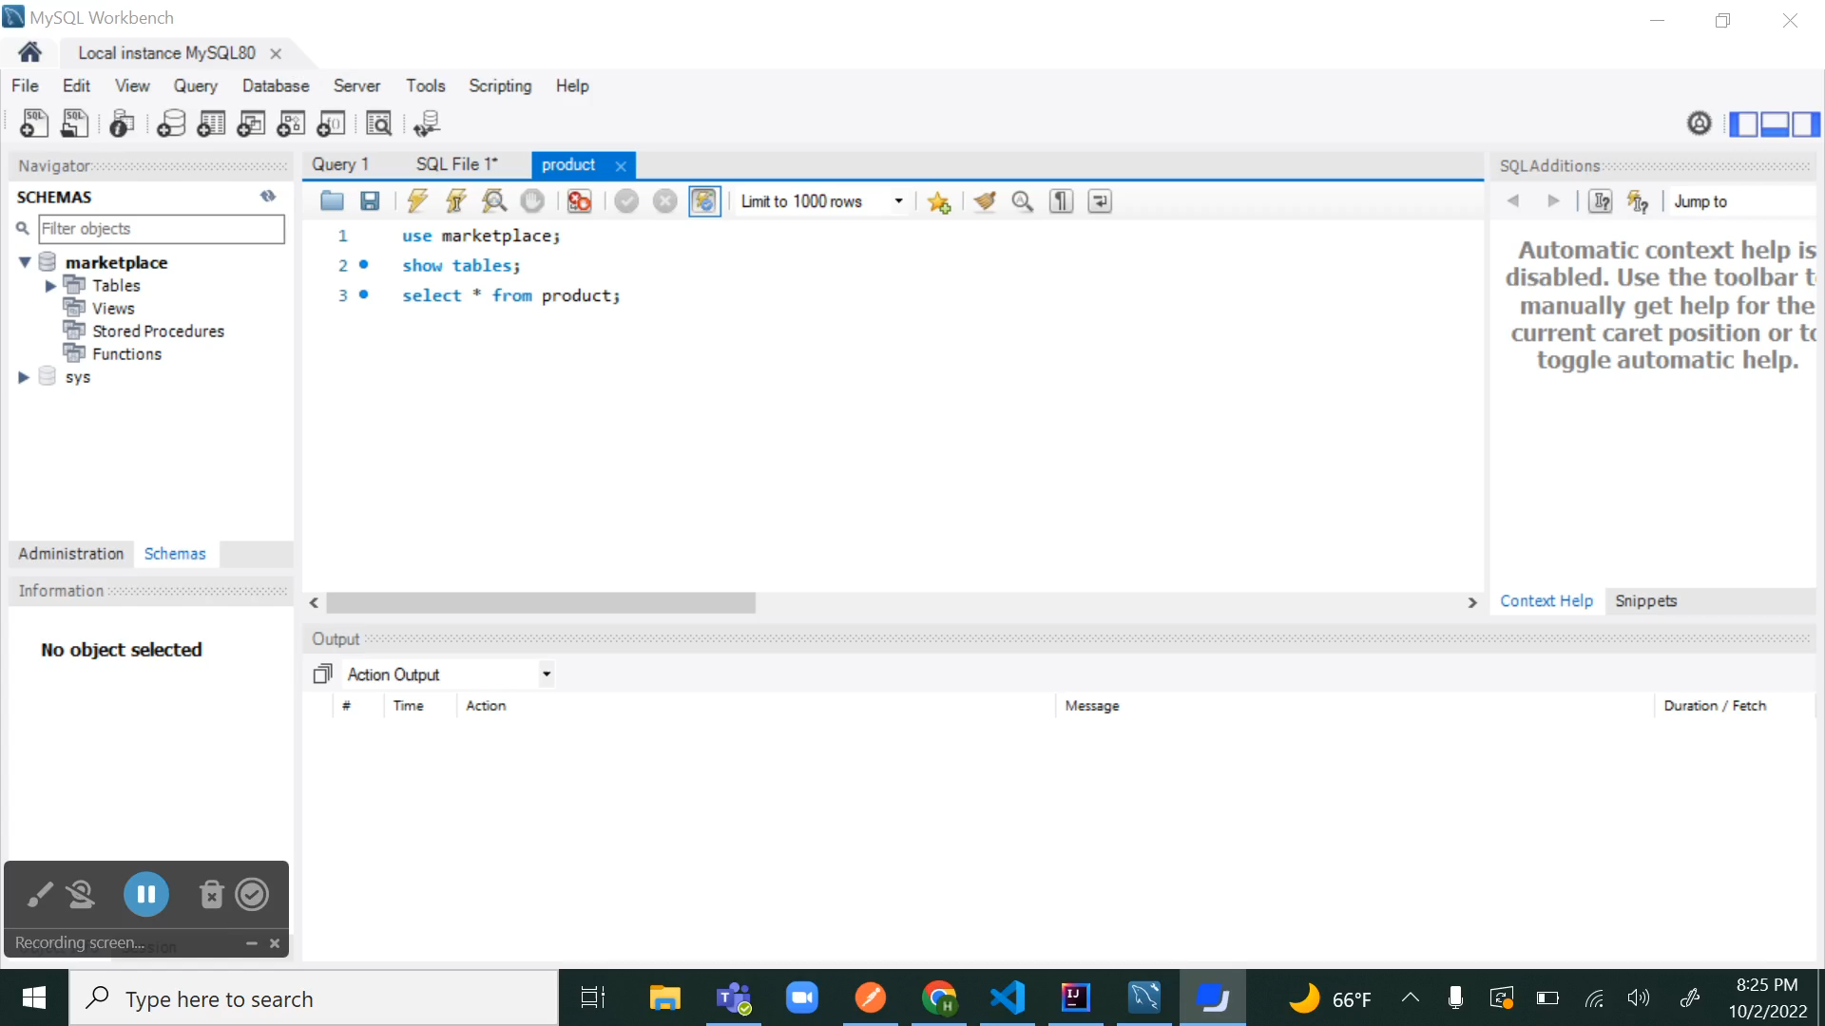
SAMPLE PRESENTATION
20
Fig-3.6 routing module in angular
Presented By Aluri Hari Kiran

Slide 23

SPRINGBOOT – DB CONNECTIVITY
21
Tables need not be created manually using DB scripts
Tables are created from Spring Boot
Uses JPA Repository
s
Presented By Sajida Mohammad By Usha Pati By Sa

Slide 24
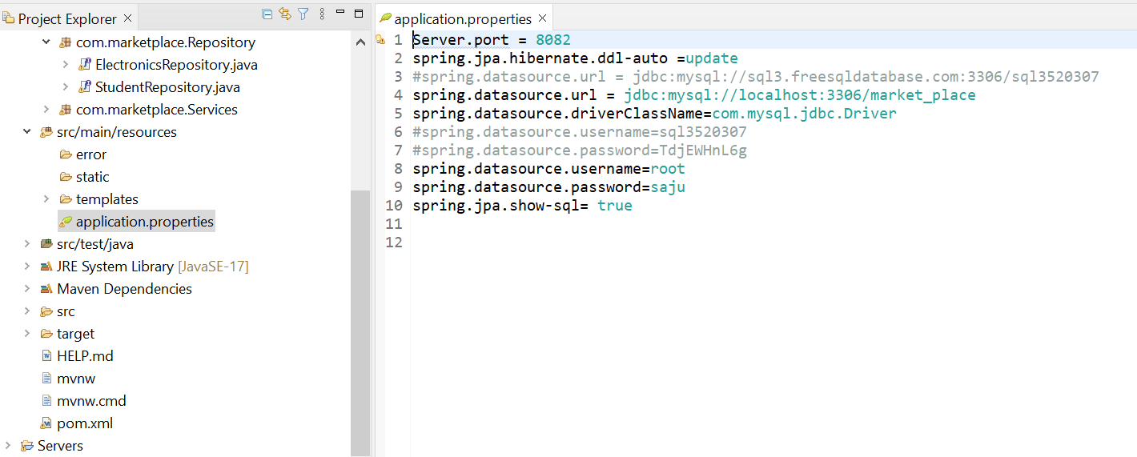
APPLICATION.PROPERTIES
22
s
Fig. 4.1 Application.properties file
Presented By Sajida Mohammad

Slide 25
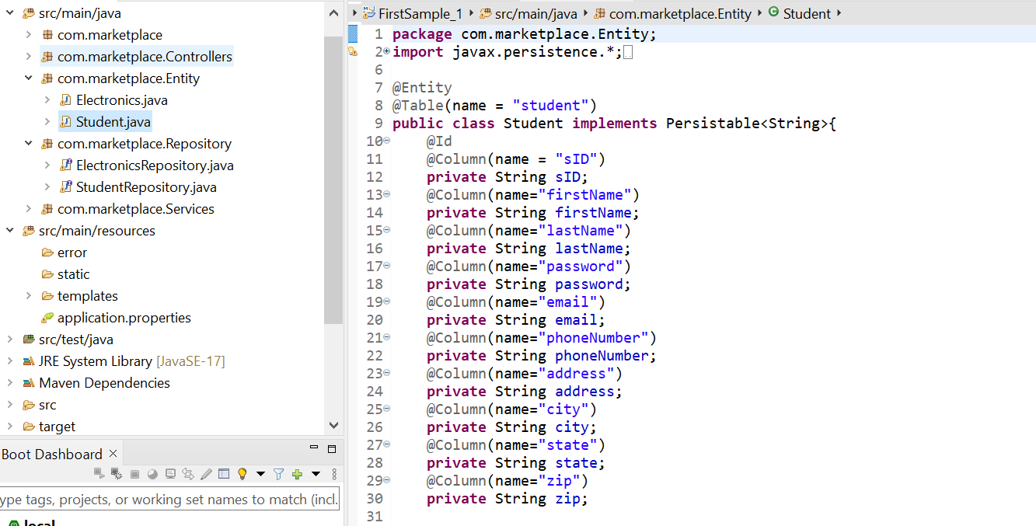
ENTITIES
23
s
Fig. 4.2 Entity
Presented By Sajida Mohammad

Slide 26
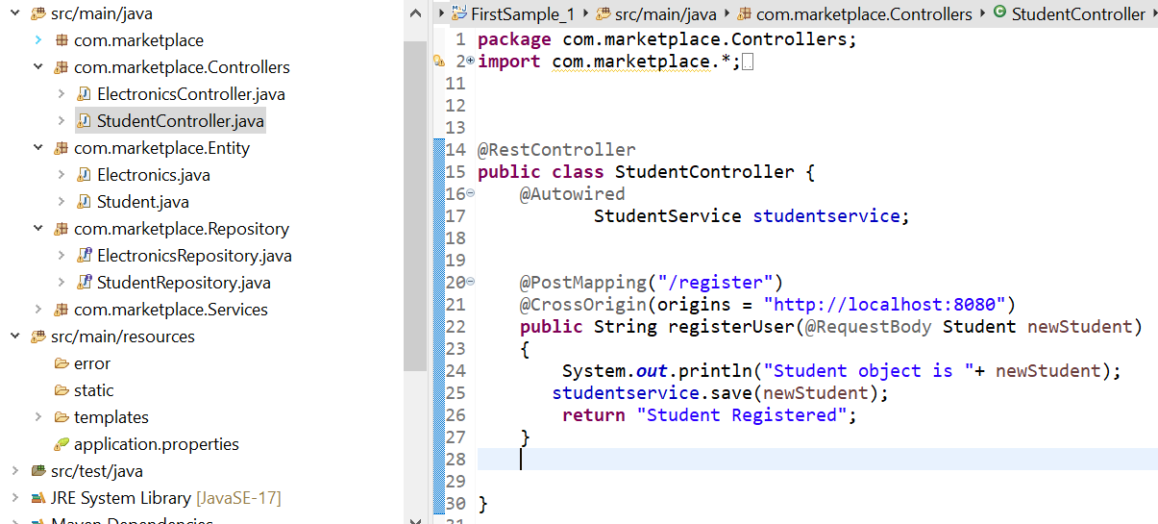
CONTROLLER
24
s
Fig. 4.3 Controller
Presented By Sajida Mohammad

Slide 27
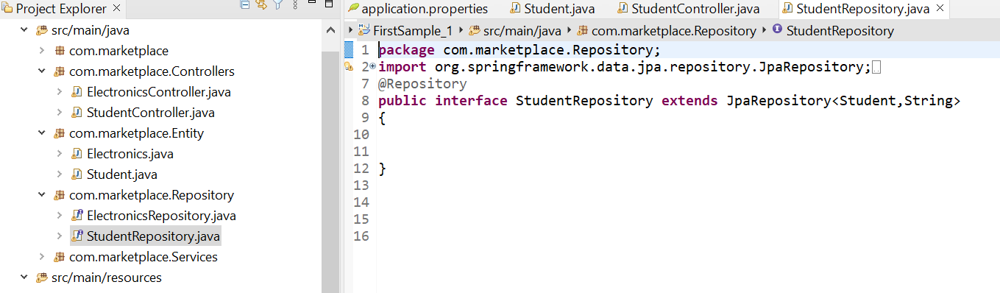
REPOSITORY
25
s
Fig. 4.4 Repository
Presented By Sajida Mohammad y Usha Pati

Slide 28

JPA REPOSITORY
26
Reduces manual effort
Easy to migrate
Lower time to develop
Presented By Sajida Mohammad

Slide 29
LESSONS LEARNT
27
Storing all the product details in a single table
Issues with storing data in a remote database
Storing of password field in database
Presented By Sajida Mohammad

Slide 30
SUMMARY
28
ER- diagram
Remote data base
Product Registration API
Spring Boot and DB – Connectivity
JPA & Advantages
Presented By Sajida Mohammad​

Slide 31
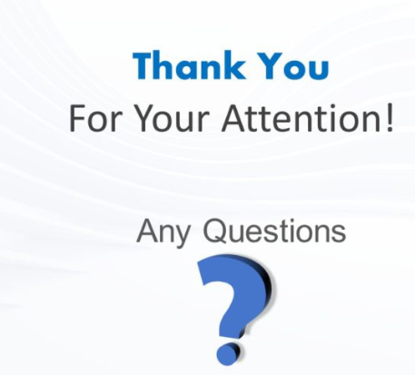
29

Slide 32
TEAM MEMBERS
USHA PATI
KIRAN KUMAR
GUNDAPUNENI
DR.CHANDRA MOULI
KOTTETI
HARI KIRAN ALURI
SAJIDA MOHAMMAD

Slide 33
MARKETPLACE FOR NORTHWEST One place to buy and sell
Sec 03 TEAM03
DR. CHANDRA MOULI KOTTETI – Client/Mentor
USHA PATI – Tester/QA
KIRAN KUMAR GUNDAPUNENI – Backend developer
HARI KIRAN ALURI – Front End Developer
Sajida MOHAMMAD – Backend developer

